Slide 1
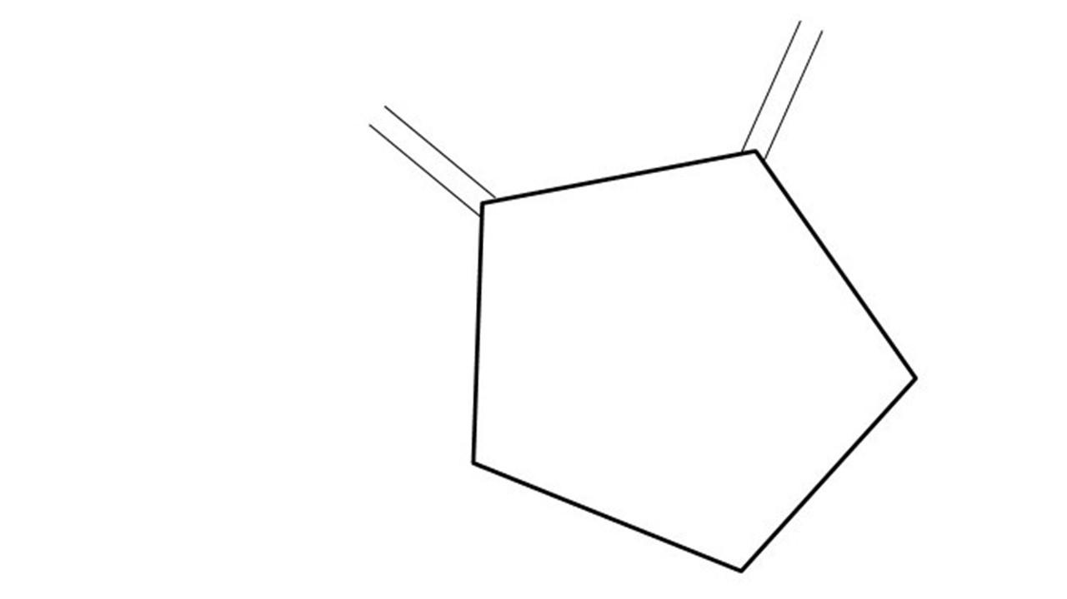
Great Cow BASIC Part 19
Great Cow BASIC for the PIC16F171xx chip Family
October 2022

Slide 2
Videos...
Install the hardware and make the board work – three LED programs
Make four LEDs flash in a sequence
Set the LEDs to represent the value of ADC
Sequence the LEDs with a delay using the value of ADC
Using an input to set the state of the LED
Using the reset switch
Using the switch, ADC – the LEDs flash in a sequence with reverse
Using the serial to display values
Using the timer0 overflow, 8bit timer, 16bit timer to flash the LEDs
Using CCP/PWM to dim the LEDS
Using I²C with serial to discover I2C devices
Using EEProm – showing values on the serial terminal
Using an I²C GCLD display
Using an SPI GCLD display
Using PWM to dim the LEDS
Using memory within the PIC – Progmem and SAF memory
The Great Cow BASIC tool chain
Assembly and alternatives assemblers
Summary

Slide 3
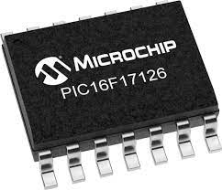
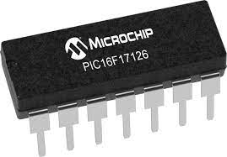
PIC16F171xx
PIC16F171xx is a high performance PIC16
Digital and Analog peripherals
12-bit ADC
Multiple communication interfaces
Serial, I2C, SPI
PWM – CCP/PWM and 16Bit
Configurable Logic Cells
OpAmp
The PIC16F171xx offers 8 to 20 pin products in small footprint packages to support customers in a variety of space constrained and sensor node applications.

Slide 4
Great Cow BASIC Compiler
Great Cow BASIC is an Open Source compiler for Microchip PIC &AVR and Logic Green AVR microcontrollers
Great Cow BASIC now supports the 16F171xx chip family
Great Cow BASIC is a cross platform with common code translation
Great Cow BASIC Compiler

Slide 5
The core compiler
High Level Language
Reports:
TXT and HTML
Source Code
Great Cow BASIC Compiler
Great Cow BASIC Compiler
Preprocessor
Code Translator
Assembler
Linker
Assembly Language
ASM file
Absolute Machine Code
HEX file
Libraries
8 bit PIC and AVR

Slide 6
Using MPLAB-X
High Level Language
Reports:
TXT and HTML
Source Code
PIC-AS,
MPLAB-IDE
Great Cow BASIC Compiler
Great Cow BASIC Compiler
Preprocessor
Code Translator
Assembler
Linker
Assembly Language
file
Absolute Machine Code
HEX file
Libraries
8 bit PIC and AVR

Slide 7
Hardware
Microchip Low Pin Count Demo Board
16F17126
18F16Q40
Arduino – mega328p
LGT328p

Slide 8
Lab
We will see
Creation of a user program and load into multiple chips

Slide 9
Resources
Tutorial source code
https://github.com/GreatCowBASIC/Demonstration_Sources/tree/main/Vendor_Boards/Great_Cow_Basic_Demo_Board/16F17126_chiprange_demonstrations
Tutorial presentations
https://github.com/GreatCowBASIC/Demonstration_Sources/tree/main/Vendor_Boards/Great_Cow_Basic_Demo_Board/16F17126_chiprange_demonstrations/tutorials

Slide 10
PIC16F171xx
PIC16F171xx is a high performance PIC16
Digital and Analog peripherals
12-bit ADC
Multiple communication interfaces
Serial, I2C, SPI
PWM – CCP/PWM and 16Bit
Configurable Logic Cells
OpAmp
The PIC16F171xx offers 8 to 20 pin products in small footprint packages to support customers in a variety of space constrained and sensor node applications.

Slide 11
Great Cow BASIC Part 19
Great Cow BASIC for the PIC16F171xx chip Family
October 2022

